Slide 1
MySQL
Relational Database Management System (RDBMS)
Easy to use
It is secure
Client/ Server Architecture
Free to download
It is scalable
Speed
High Flexibility
Dual Password Support
GUI Support
Partitioning
Platform Independent
High Productivity

Slide 2
PostgreSQL
Compatible with Data Integrity
Support multiple features of SQL
Compatible with multiple data types
Highly extensible
Secure
Highly Reliable

Slide 3
SQL Server
The core component of Microsoft SQL Server is the SQL Server Database Engine, which controls data storage, processing and security. It includes a relational engine that processes commands and queries and a storage engine that manages database files, tables, pages, indexes, data buffers and transactions. Stored procedures, triggers, views and other database objects are also created and executed by the Database Engine.

Slide 4
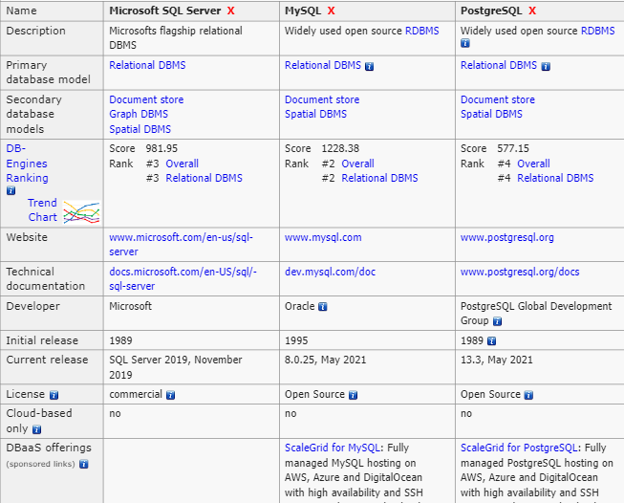
A comparison between the three RDBMS

